Slide 1

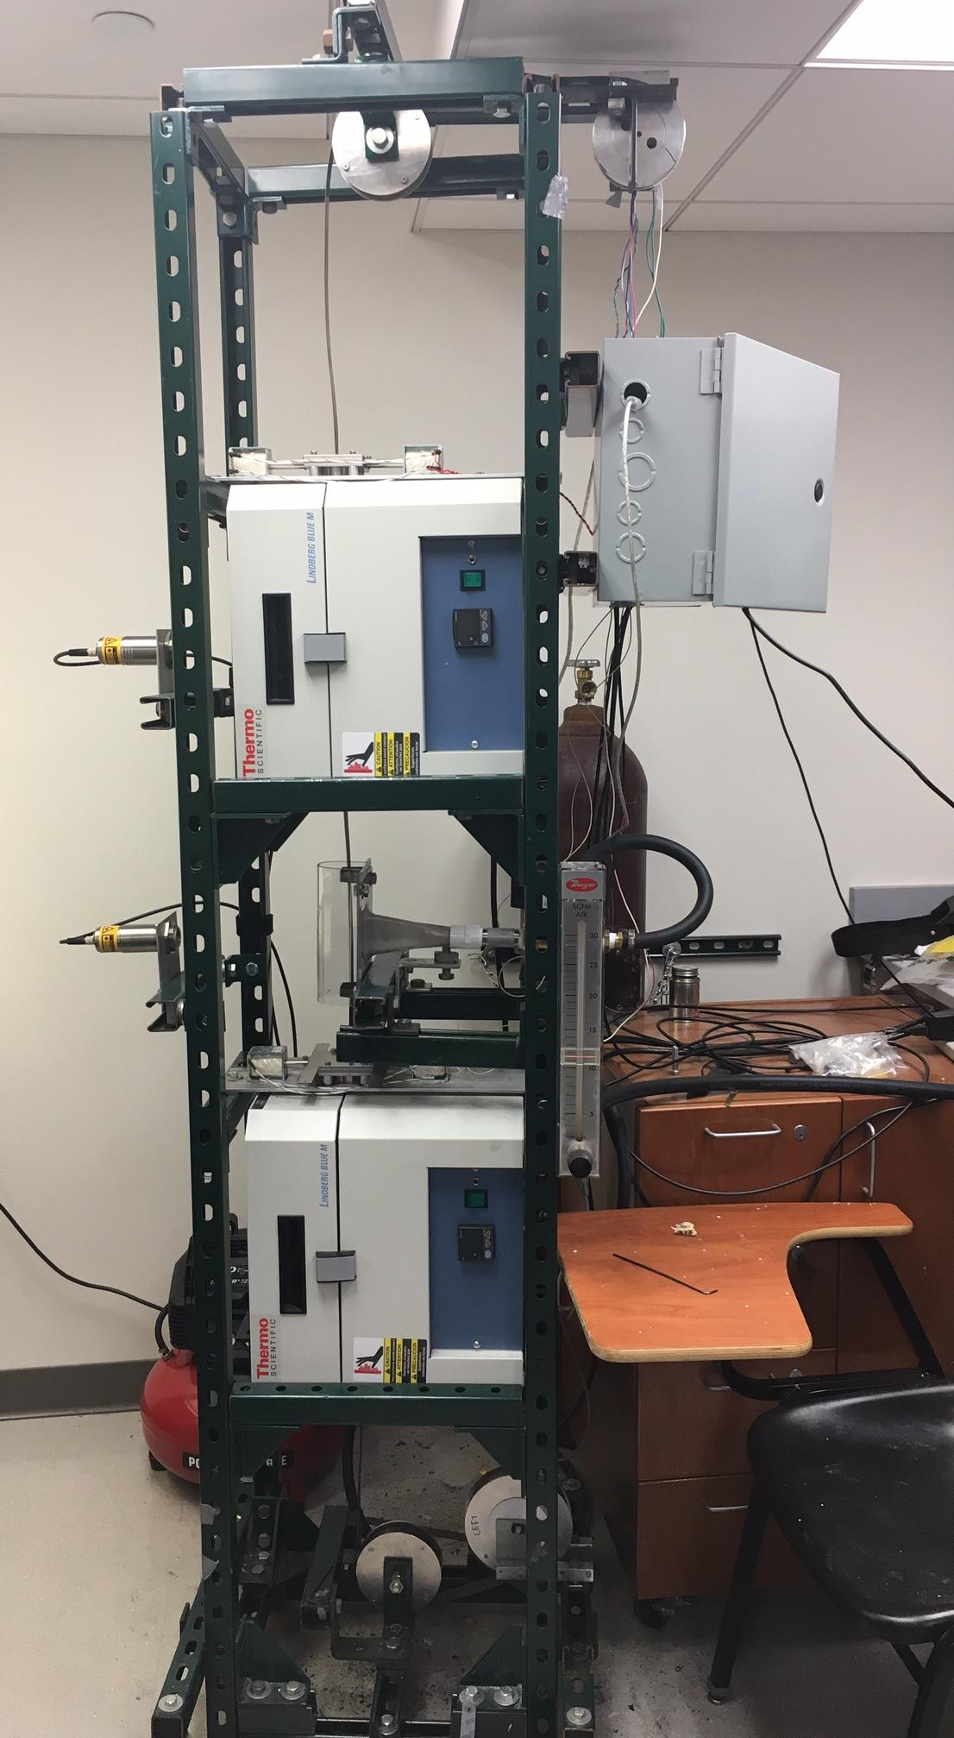
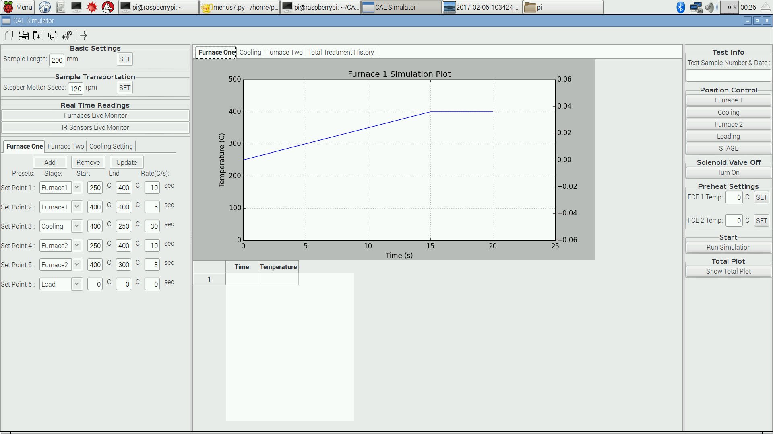
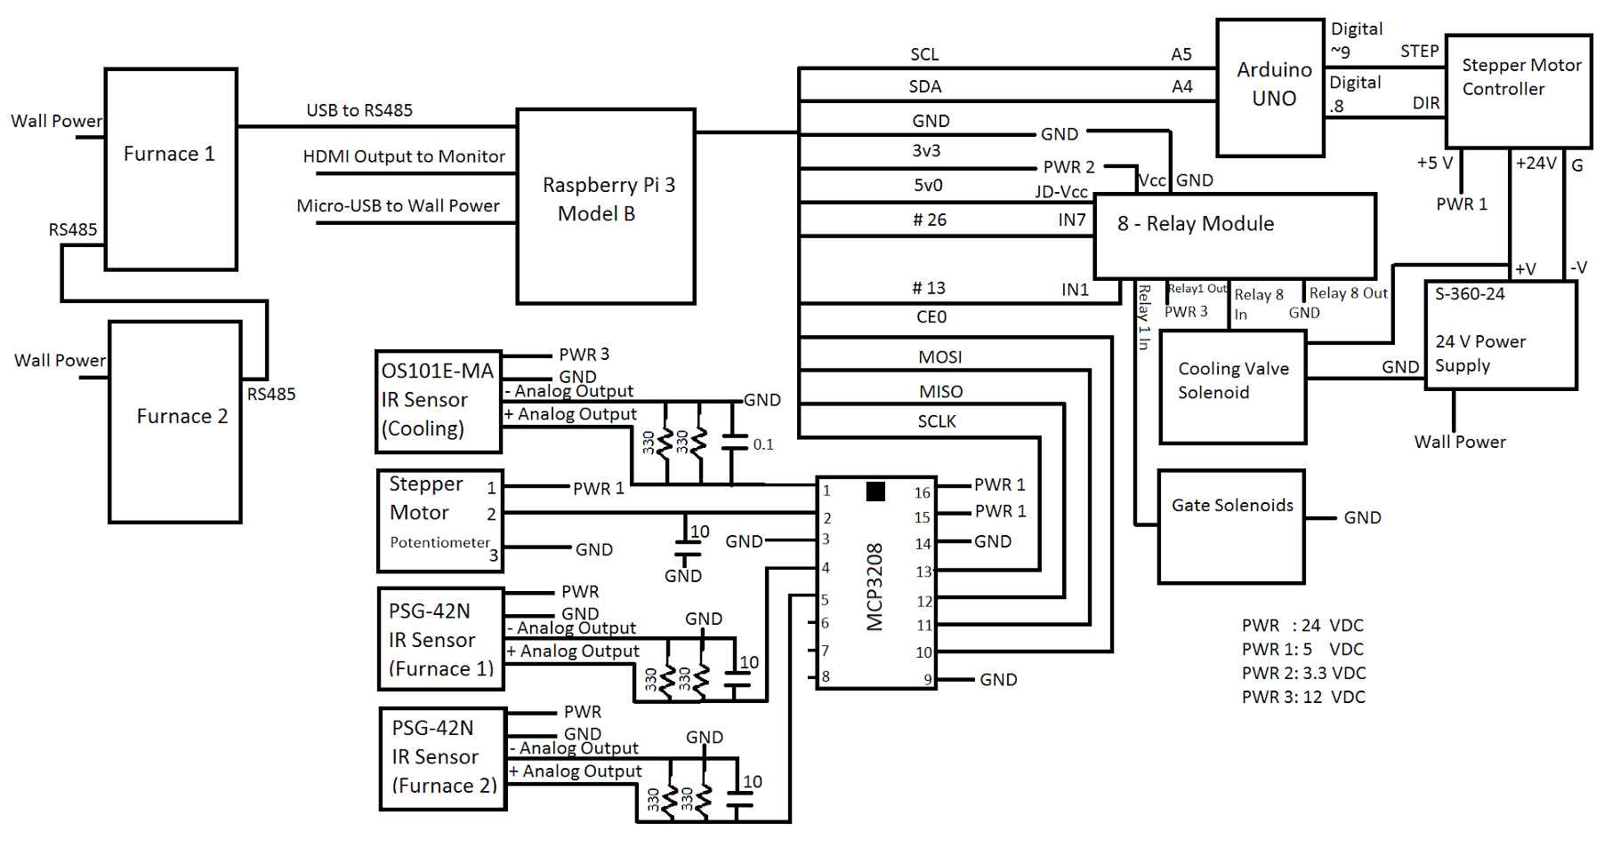

CAL: Continuous Annealing Line Simulator
Department of Computer and Electrical Engineering,
Swanson School of Engineering, University of Pittsburgh
Andrew Zundel, Daniel Figula, and Kaitlyn Carey
Set-up and Simulation
Background
The continuous annealing line simulator (CAL simulator-VS1) is a special piece of laboratory equipment that is used to anneal advanced high strength steels (AHSS similar to the automotive industry. This system is capable of annealing strip samples to produce the required microstructures in AHSS.
System and Outline
User Interface
Set Up:
For proper positioning manual tension adjustment to the belt before starting
The sample must be staged with the appropriate sample length
All electrical components must be turned on for proper operation
System Wiring Diagram
Annealing Process:
First Heating: The sample is brought to a range where the microstructure of the steel forms into a percentage of ferrite and austenite.
Cooling: The sample is then rapidly cooled to a range where the Austenite turns in to Martencite. Only the Martencite and Ferrite remain in the steel. This ratio in the microstructure of the steel determines it’s strength and ductility.
Reheating: May undergo to produce a secondary manipulation of the microstructure of the steel sample
Unloading: Steel is unloaded for analysis of the microstructures.
Project Goals
Improve Positioning System to better track the sample location during simulations
Remedy gate issues so that it opens when sample is to be passed through it and remains closed otherwise to improve system temperature management
Add sensor for measuring sample temperature while in Furnace 2
Value Proposition
Provide useful data and methodologies to automotive industry partners on the production of AHSS products based on the test simulations performed on provided samples
Success Criteria
Properly control and operate the gates based on sample location
Manage the position of the sample within 0.25 inches of the desired position
Furnace 2 temperature sensor accurately measures sample temperature while positioned in Furnace 2
Application
Manual control of sample and component operation
Dynamic simulation options
Live graphs and data acquisition from sensors during simulation
Saved data for further analysis
Acknowledgments
We would like to thank our project mentors, Dr. Issac Garcia, Rafael Landa, and Bob Giles. for the opportunity to work on this project and their invaluable support. We would also like to thank Dr. Irvin Jones and the Swanson School of Engineering for providing assistance and numerous resources.

